Slide 1

EARLY DIAGNOSIS OF ALZHEIMER’S DISEASE USING DEEP LEARNING
END SEM PRESENTATION
S.NO | NAME | REGISTER NUMBER
1 | K.V.Jagadish Krishna | BL.EN.U4ECE16205
2 | C.SaiAbhinav | BL.EN.U4ECE16309
3 | Naresh Kumaar A.S.J. | BL.EN.U4ECE16332
Guided by
-Ms. Sunitha
Asst. Professor,
Electronics and Communication Engineering,
Amrita school of Engineering

Slide 2
CONTENTS:
Introduction
Literature Survey.
Image Processing Techniques.
Machine Learning Algorithms.
Alzheimer’s Disease.
Gabor’s filter.
3. Methodology
4. System Architecture and Design
Result and Conclusion
References

Slide 3
INTRODUCTION:
In Alzheimer disease, death of brain cells occurs which results in memory loss, poor in cognitive thinking.
Alzheimer’s disease is rapidly growing in people aged 65 and above.
There are very few treatments that cure Alzheimer's disease or alters the disease state in the brain.
Early diagnosis would help them to do their day to day work. So, it has a huge importance.

Slide 4
LITERATURE SURVEY
1.Early Diagnosis of Alzheimer’s Disease Based on Resting-State Brain Networks and Deep Learning. (2019-IEEE journal paper)
This paper has proposed a framework for the early diagnosis of AD based on deep neural networks .
The dataset has been acquired from ADNI(Alzheimer’s disease neuroimaging association database).
Functional brain networks have been built based on the correlation of R-fMRI signals.
Experimental results demonstrate that distribution pattern of patient's differs from gender and age.

Slide 5
LITERATURE SURVEY
2. A Segmentation Technique To Detect The Alzheimer's Disease Using Image Processing (2017-IEEE conference paper)
This paper talks about various types of image segmentation methods and filters that can be used for better processing.
The MRI images are used to do the segmentation process.
In this process, Watershed algorithm has been used.
The final outcome after we use this algorithm is the affected area in an MRI image can be detected.

Slide 6
LITERATURE SURVEY
3.Early Diagnosis of Alzheimer’s Disease using machine learning.
(2018-IEEE conference paper)
The aim of this paper is making use of Machine Learning algorithms for the detection of Alzheimer’s disease.
Clustering algorithms have also been implemented along with Fuzzy interference system.
The detection of Alzheimer’s disease has been done using RAVLT(Rey Auditory verbal Learning Test) percentage.
If RAVLT% is high, the chances of patient being affected with the Alzheimer’s disease is found to be high.

Slide 7
LITERATURE SURVEY
4.Early Diagnosis of Alzheimer’s Disease using machine learning techniques. (2018-IEEE conference paper)
This paper talks about implementation of machine learning techniques using Support vector machine and KNN mode of clustering.
SVM and KNN methods have been used for classification and regression.
Using SVM, the accuracy that was achieved is 97.56%.
Using KNN, the accuracy that was achieved is 95.00%.

Slide 8
LITERATURE SURVEY
5.On the feature extraction performances of CNN Gabor-Type filters in Texture Recognition Applications (2016- IEEE Conference paper)
This paper talks about the implementation of Gabor filters for feature extraction in Image Processing Applications.
GF achieve minimum space frequency Bandwidth product being capable of extracting both local and frequency information.
There are 2 types of Gabor filters:- Simple GF and 2D GF.
The experimental results show that the Accuracy has been increased by 10% using CNN Gabor filter.

Slide 9
METHODOLOGY
In the proposed approach, various shape and texture features are extracted from the Hippocampus for detection of Alzheimer’s disease.
From the training dataset features are extracted using Convolution Neural Network (CNN) and a training model is processed and it gives a validation model.
Test data has to give to validation model which was build using CNN.
The validation model has to extract the features from the input MRI scan image and classify the Alzheimer category.

Slide 10
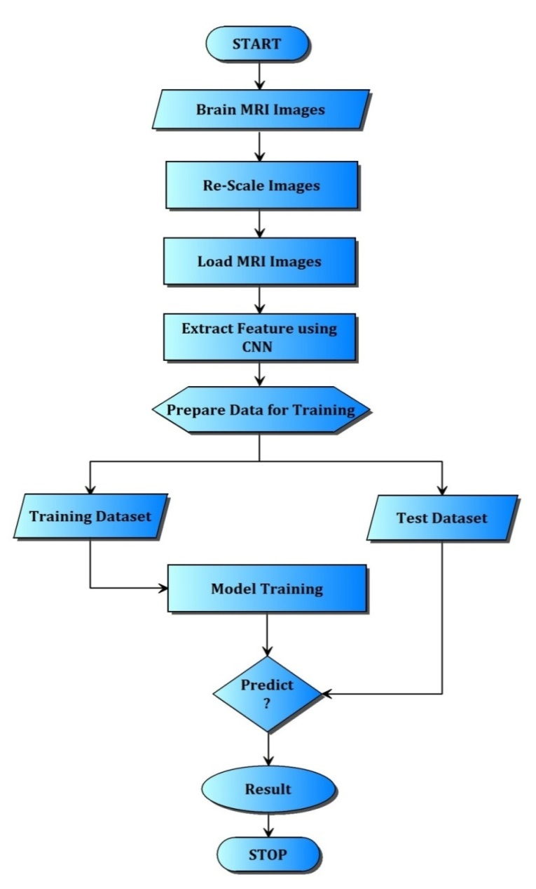
FLOWCHART:

Slide 11
SYSTEM ARCHITECTURE:
A system architecture diagram would be used to show the relationship between different components. Usually they are created for systems which include hardware and software and these are represented in the diagram to show the interaction between them.
Image Acquisition and Pre-processing
Data Preparation and Model construction
Model training
Model testing and evaluation

Slide 12
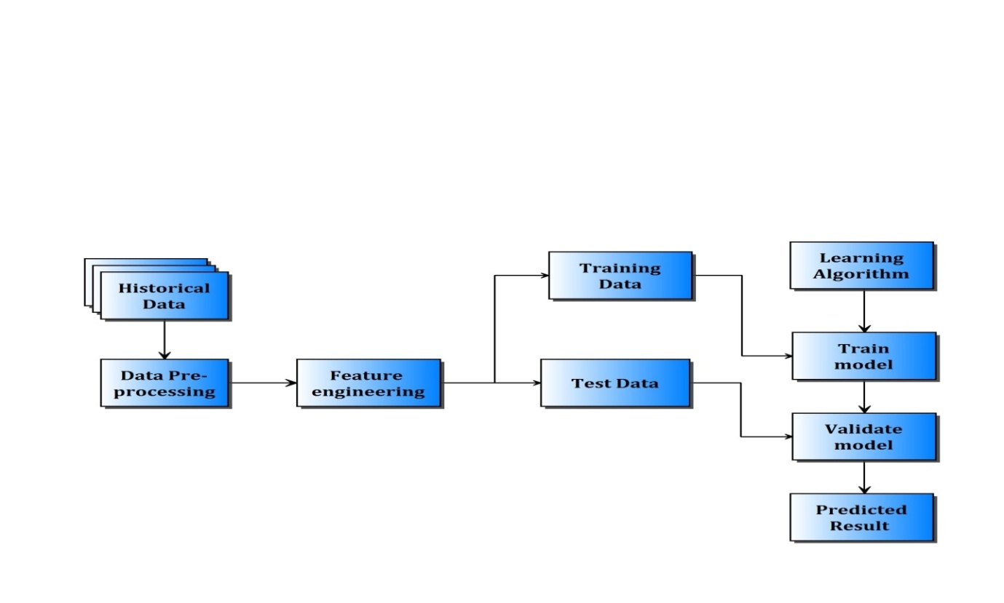
SYSTEM ARCHITECTURE:

Slide 13
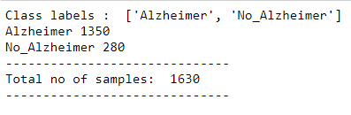
RESULT:
Number of input MRI samples.

Slide 14
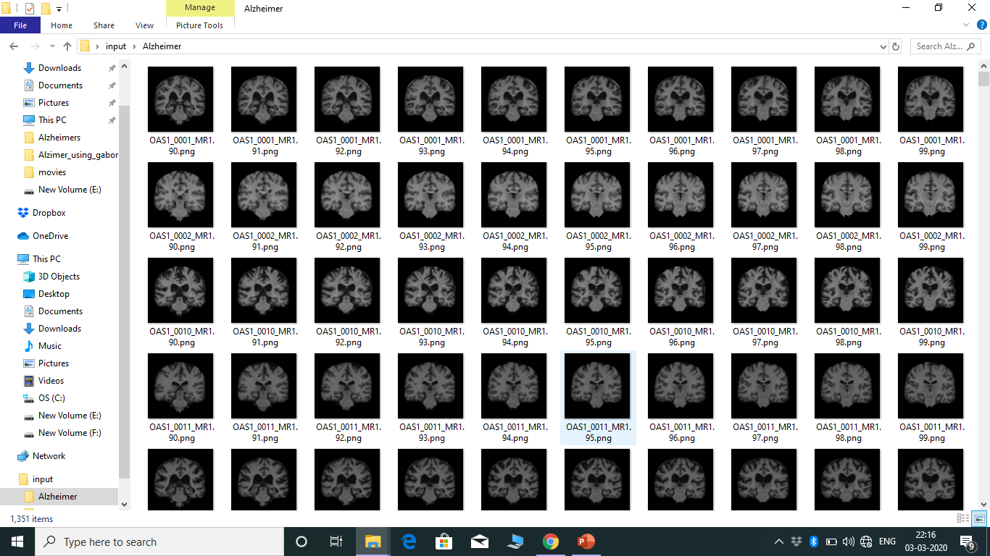
RESULT:
This is the data set acquired from oasis and kaggle

Slide 15

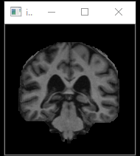
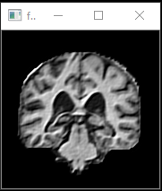
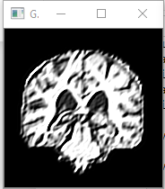
PRE-PROCESSING:
Gabor Kernel
Original Image
2D Filtered Image
Gabor filter Image

Slide 16
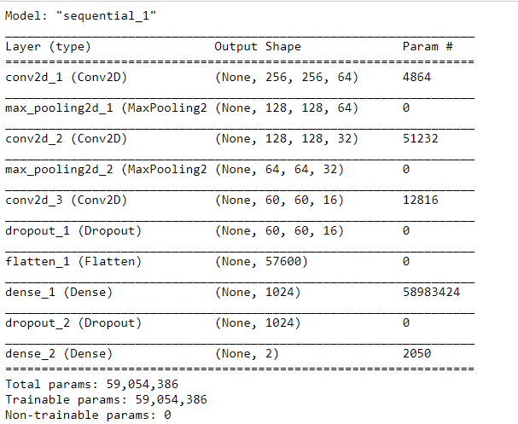
Sequential steps for Data Modelling:

Slide 17
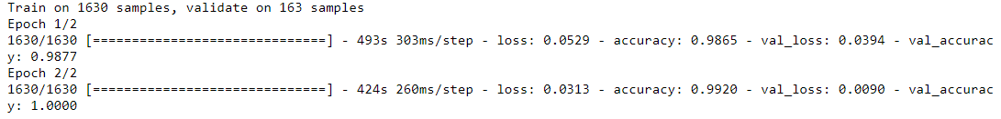
TRAINING PHASE:
The above figure shows the Training phase accuracy which is found out to be 99.20%.

Slide 18
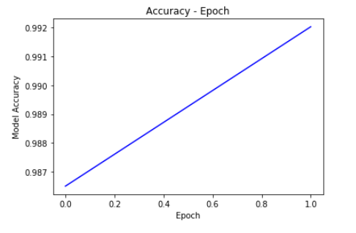
ACCURACY EPOCH:
This graph shows the accuracy which is found out to be 99.20%.

Slide 19
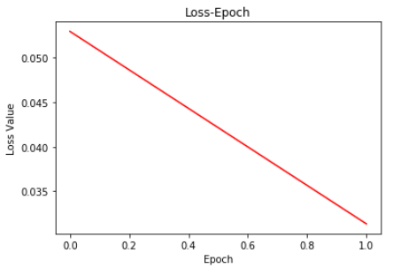
LOSS EPOCH:
This graph shows the loss curve which is found out to be 0.8%.

Slide 20

CONFUSION MATRIX:
This figure represents the confusion matrix from which Accuracy, recall, precision etc. can be found.

Slide 21
TESTING PHASE:
The above figure denotes the input that we give to the testing phase. Here, a sample of 7 images is taken into consideration. These 7 images are given indices from 0 to 6. We can enter the index of the image for which we wish to predict the output i.e., if that person is affected with Alzheimer’s or not. Here, we have selected the index to be 6. The result is displayed in Fig-5.9 as “Alzheimer” or “No_Alzheimer” accordingly.

Slide 22
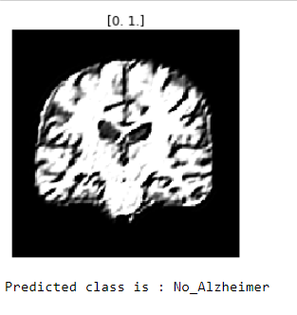
THE FINAL RESULT:
This figure shows the final output. It shows if the selected input image has Alzheimer’s or not. Here, in this scenario, the image that we had selected is not affected with Alzheimer’s disease. Hence, it is displayed as “No_Alzheimer”.

Slide 23
CONCLUSION:
Data set containing 1600 MRI images of Brain has been taken from Oasis and Kaggle.
Data pre-processing has been done using Gabor’s filter using two stages.
The confusion matrix has also been generated from which we can find various parameters like Accuracy, Precision, Recall, f1 etc
The Accuracy Epoch and Loss Epoch have been plotted.
We conclude the experimental result what we are getting from developed system is more than 95% Accurate.

Slide 24
References:
R. Ju, C. Hu, p. zhou and Q. Li, "Early Diagnosis of Alzheimer's Disease Based on Resting-State Brain Networks and Deep Learning," in IEEE/ACM Transactions on Computational Biology and Bioinformatics, vol. 16, no. 1, pp. 244-257, 1 Jan.-Feb. 2019.
R. C. Petersen, et al., “Current concepts in mild cognitive impairment,” Archives Neurol., vol. 58, no. 12, pp. 1985–1992, 2001.
T. Kam, H. Zhang, Z. Jiao and D. Shen, "Deep Learning of Static and Dynamic Brain Functional Networks for Early MCI Detection," in IEEE Transactions on Medical Imaging, vol. 39, no. 2, pp. 478-487, Feb. 2020.
M. Wang, C. Lian, D. Yao, D. Zhang, M. Liu and D. Shen, "Spatial-Temporal Dependency Modeling and Network Hub Detection for Functional MRI Analysis via Convolutional-Recurrent Network," in IEEE Transactions on Biomedical Engineering.

Slide 25
References:
5) H. Fuse, K. Oishi, N. Maikusa, T. Fukami and J. A. D. N. Initiative, "Detection of Alzheimer's Disease with Shape Analysis of MRI Images," 2018 Joint 10th International Conference on Soft Computing and Intelligent Systems (SCIS) and 19th International Symposium on Advanced Intelligent Systems (ISIS), Toyama, Japan, 2018
6) S. Matoug, A. Abdel-Dayem, K. Passi, W. Gross and M. Alqarni, "Predicting Alzheimer's disease by classifying 30Brain MRI images using SVM and other well-defined classifiers ",IOPjournal publication,2011
7) B. AI-Naami , N. Gharaibeh, and A. AIRazzaq Kheshman, "Automated Detection of Alzheimer Disease Using Region Growing technique and Artificial Neural Network" , ELSEVIER journal publication,2013.
8) K. R. Graya, P. Aljabara, R. A. Heckemannc, A. Hammersc, and D. Rueckerta, “Random forest-based similarity measures for multi-modal classiﬁcation of Alzheimer’s disease,” Neuroimage, vol. 65, pp. 167–175, 2013.

Slide 26
THANK YOU
-BY
K.V.Jagadish Krishna
(BL.EN.U4ECE16205)
C.SaiAbhinav
(BL.EN.U4ECE16309)
Naresh Kumaar A.S.J.
(BL.EN.U4ECE16332)

